Slide 1

Algorithms and Data Structures 2 CS 1501
Fall 2021
Sherif Khattab
ksm73@pitt.edu
(Slides are adapted from Dr. Ramirez’s and Dr. Farnan’s CS1501 slides.)

Slide 2
Announcements
Upcoming deadlines:
4/19: Assignment 4
4/21: Homework 12
4/23: Lab 11
4/30: Lab 12
5/2: Assignment 5
5/2: Bonus Homework
Tophat questions are due one week after each lecture
OMETs
1 bonus point for entire class when response rate >= 80%
Currently at ~33%
Deadline is Sunday 4/25

Slide 3
Last lecture …
(Big)Integer Algorithms
exponentiation
GCD
Encryption

Slide 4
Muddiest points
GCD
application of euclid's algorithm
extended Euclidean algorithm
is there a reason to use one GCD algorithm over the other?
could we go through another example of Euclid's algorithm and extended Euclidean algorithm
why is ax + by = i important / the point of XGCD
Exponentiation
the bottom-up approach and where it would be applicable
Encryption
alice bob example
the pad
How do we do modular addition/subtraction?
how does one time pad encryption run out of keys?
Is the one-time pad encryption algorithm commonly used?
how does my computer have good encryption if i've never had to meet anybody to exchange pads
how are encryption keys shared in practical applications
the symmetric cipher
what makes symmetric ciphers better

Slide 5
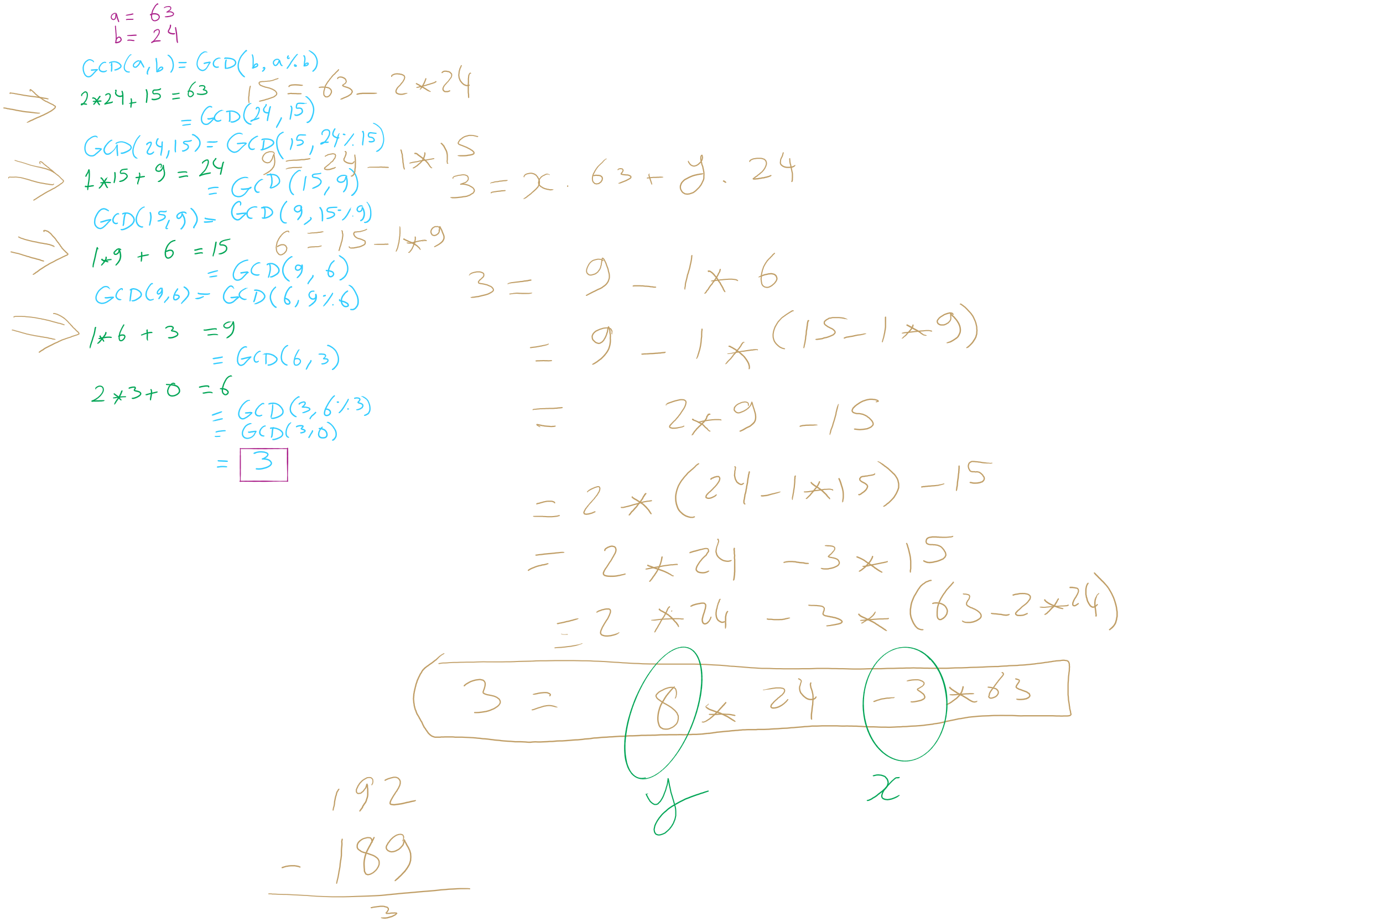
GCD/XGCD Example 1

Slide 6
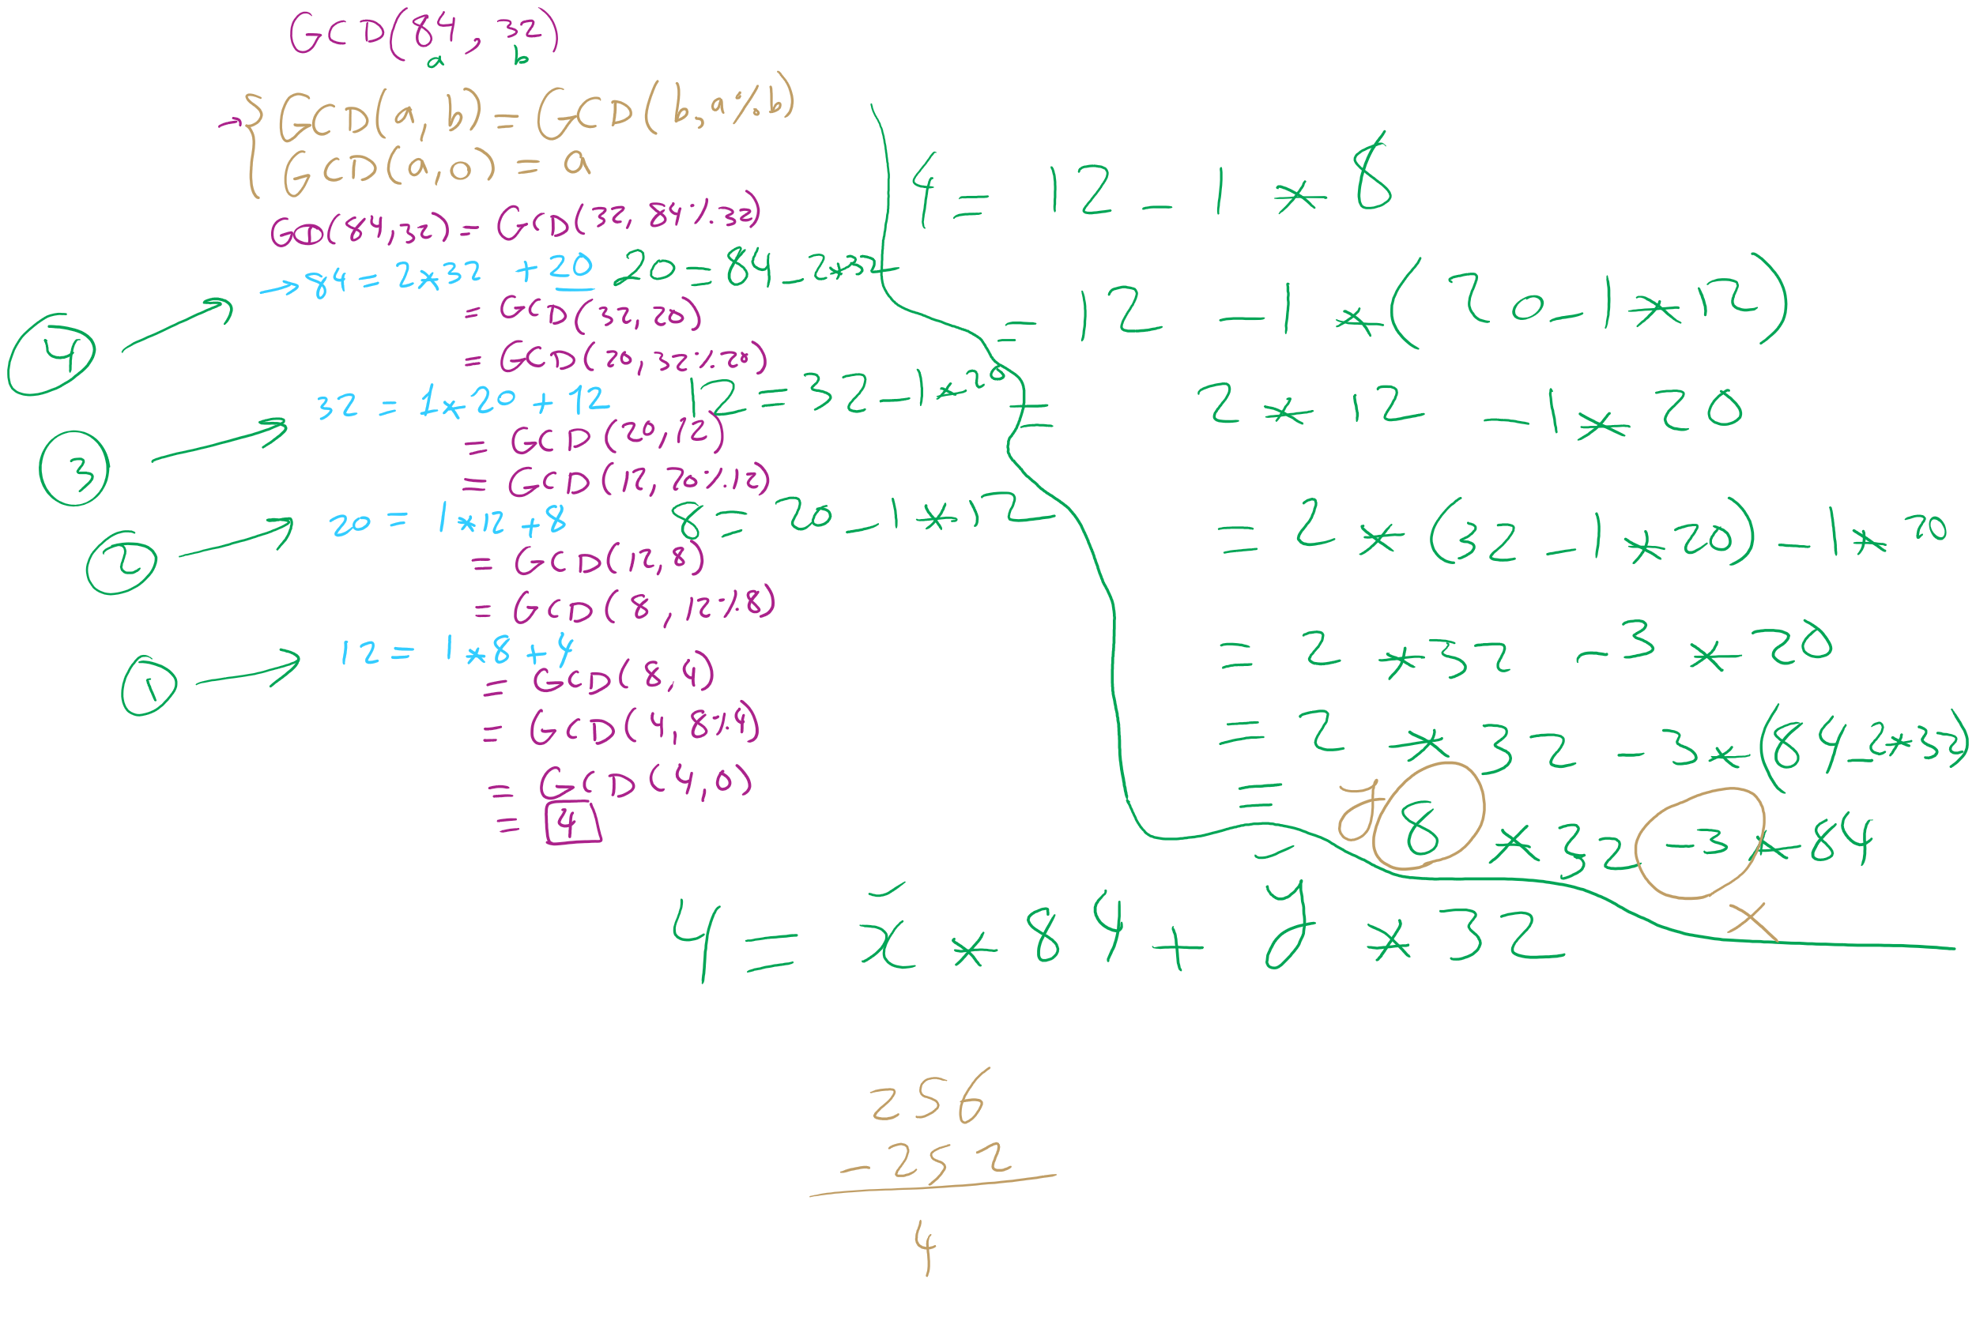
GCD/XGCD Example 2

Slide 7
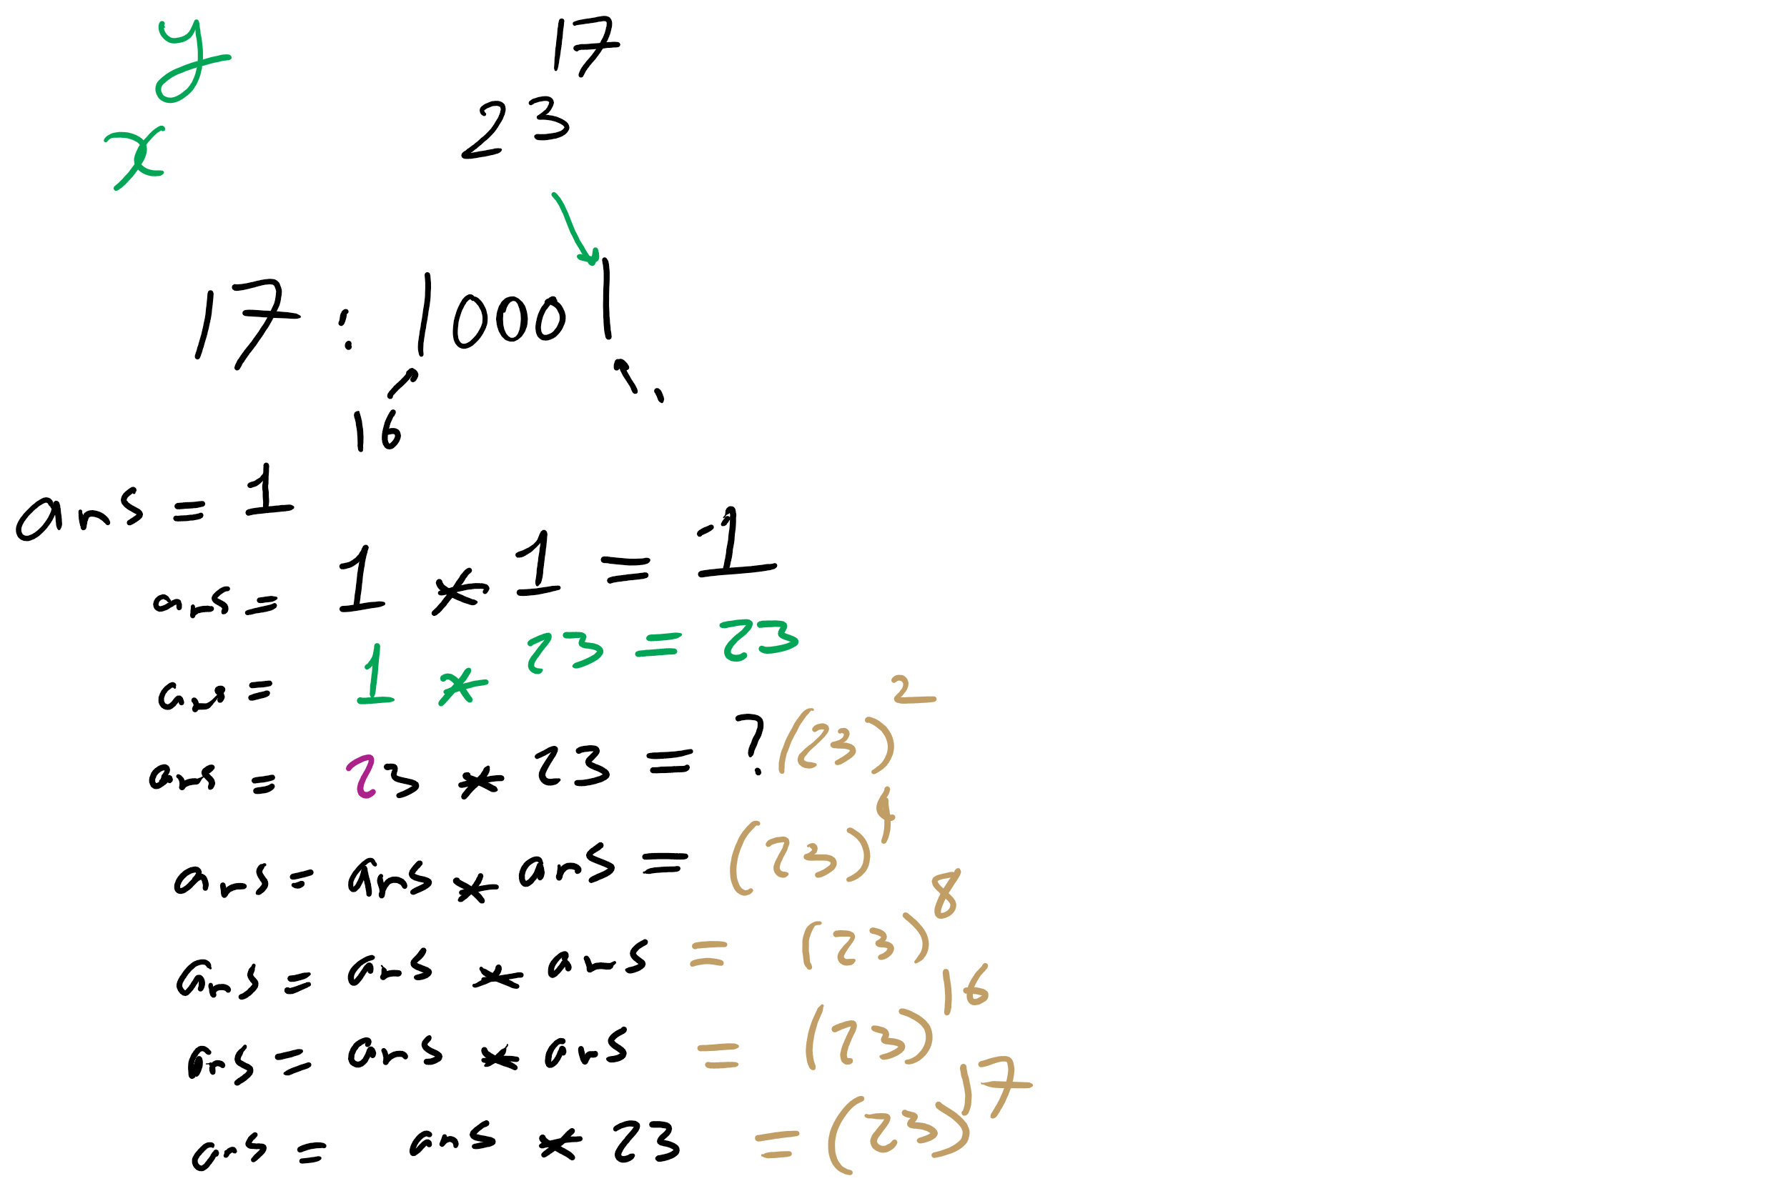
Bottom-up Exponentiation Example 1

Slide 8
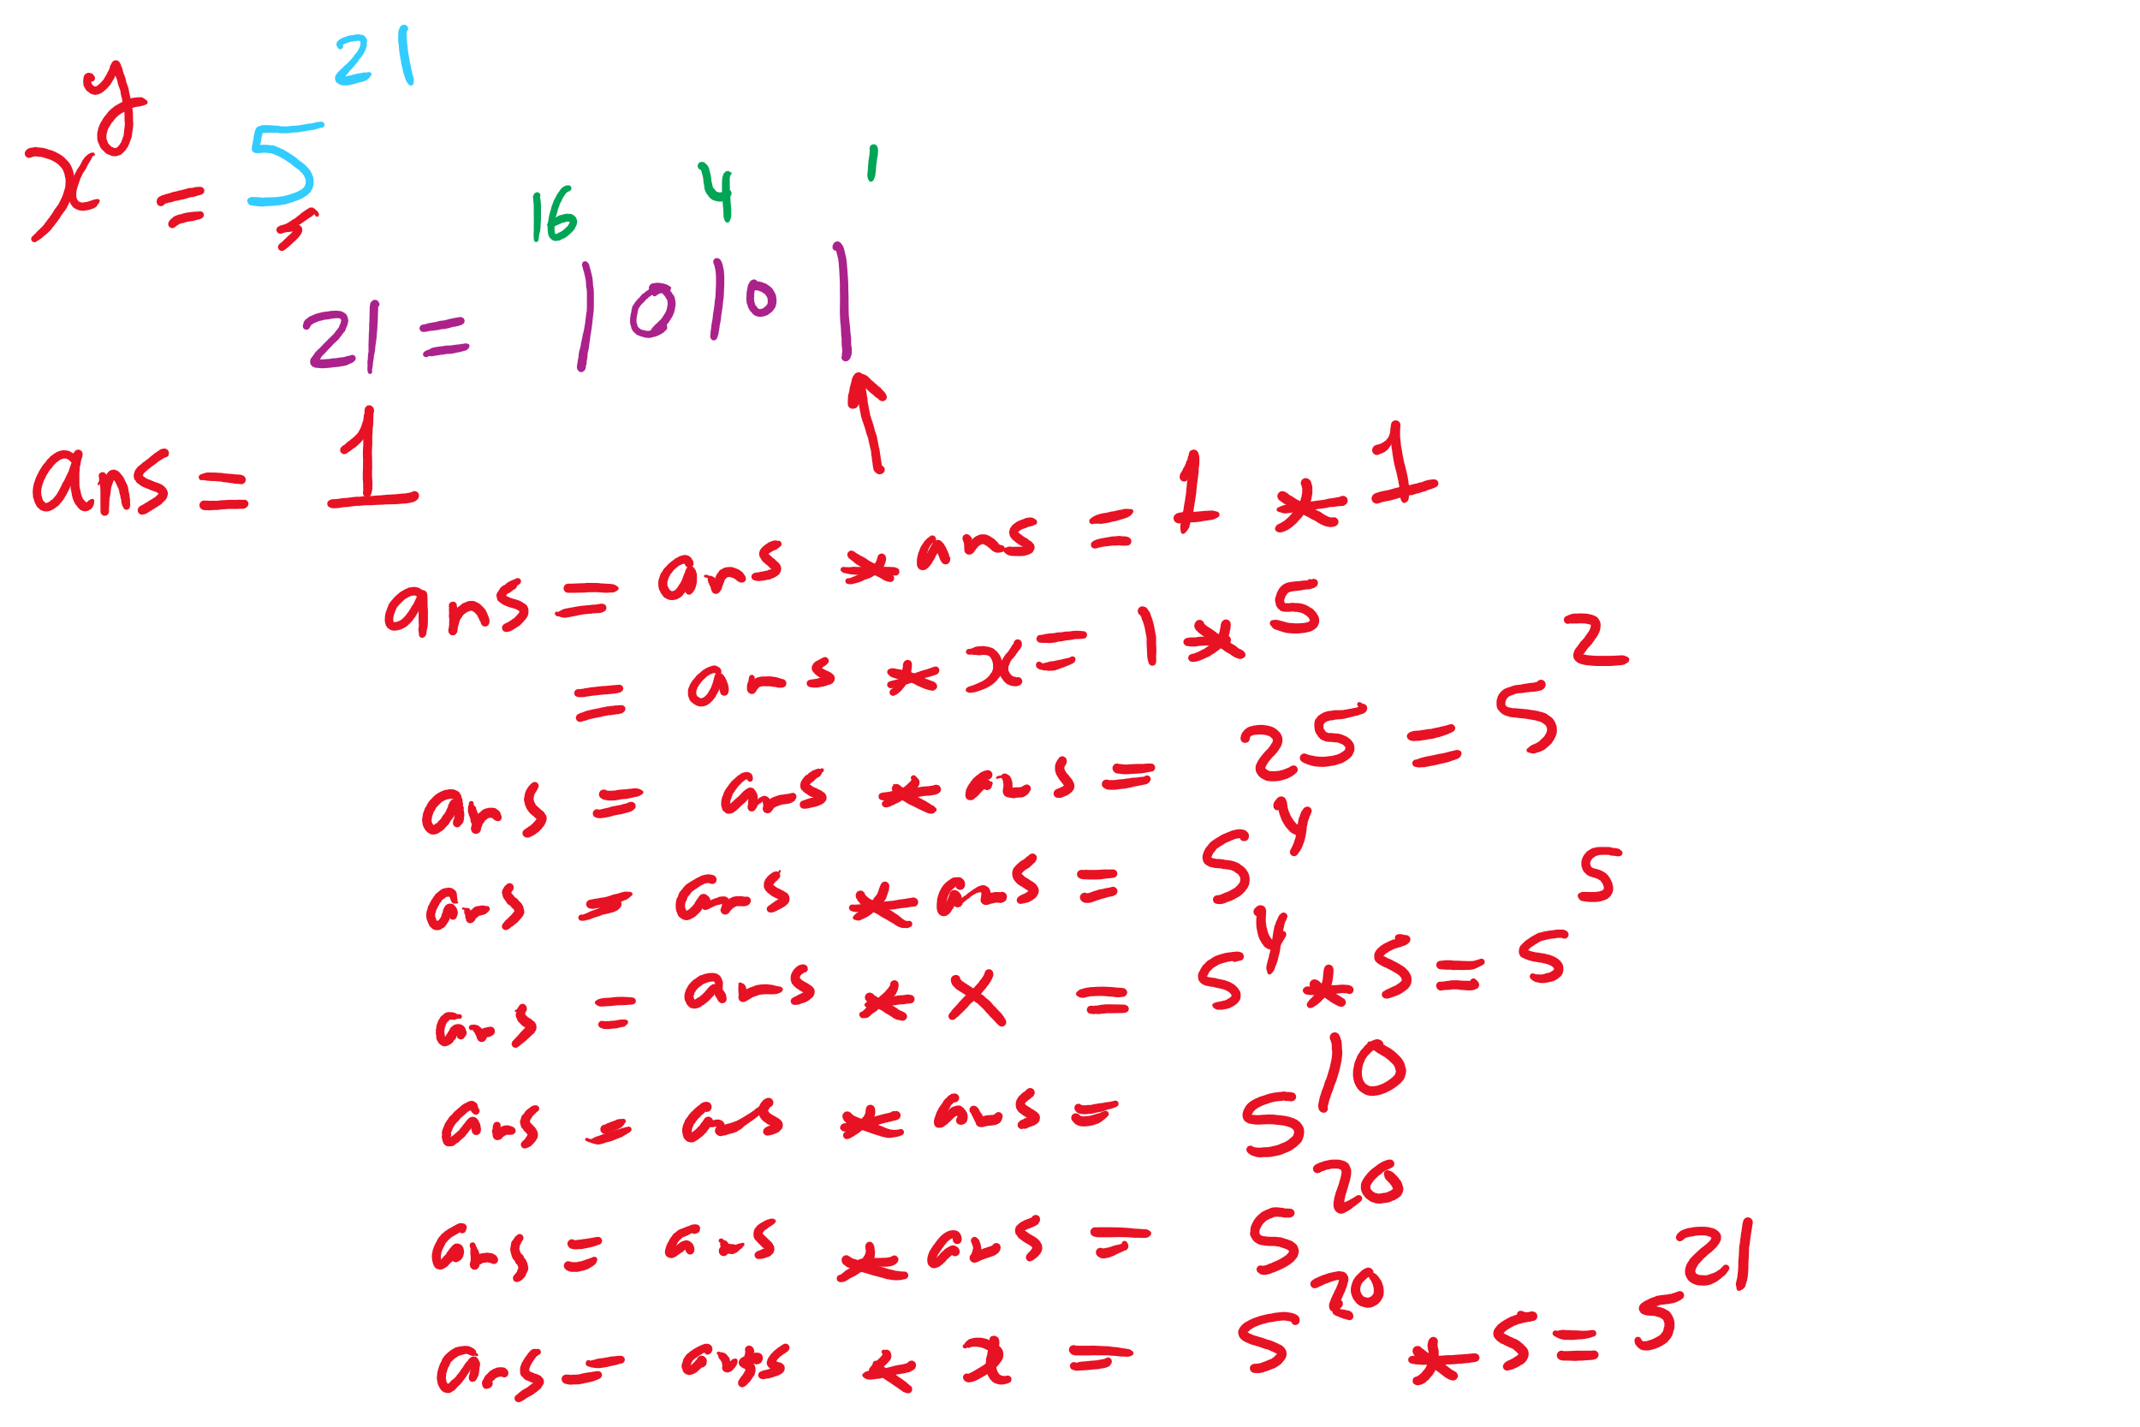
Bottom-up Exponentiation Example 2

Slide 9
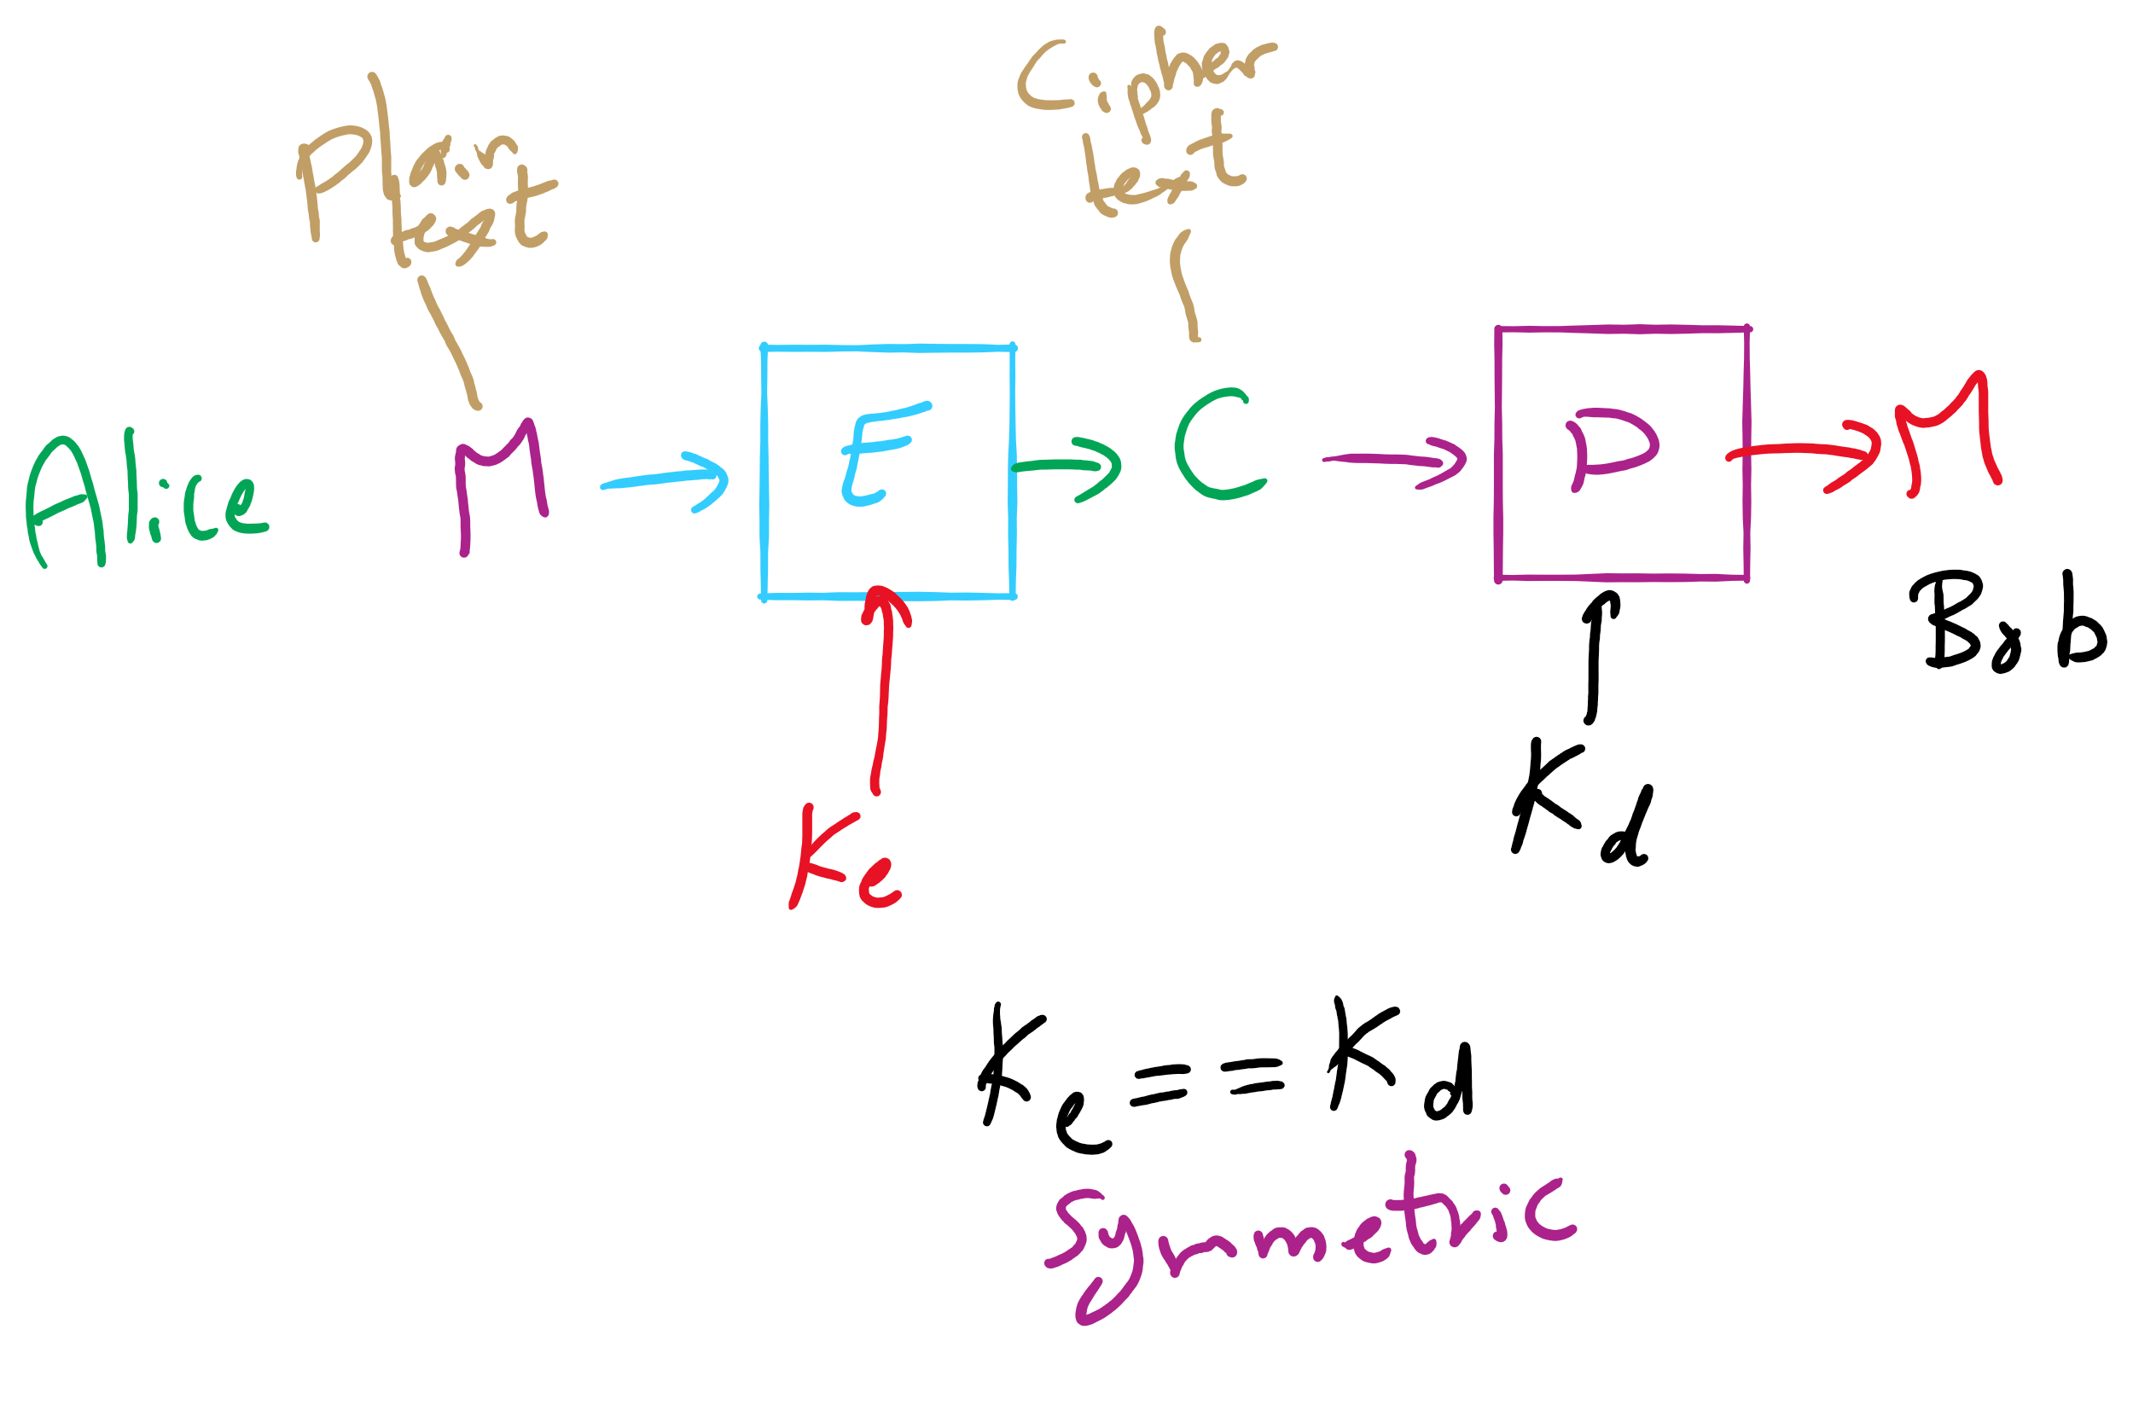
Encryption Model

Slide 10
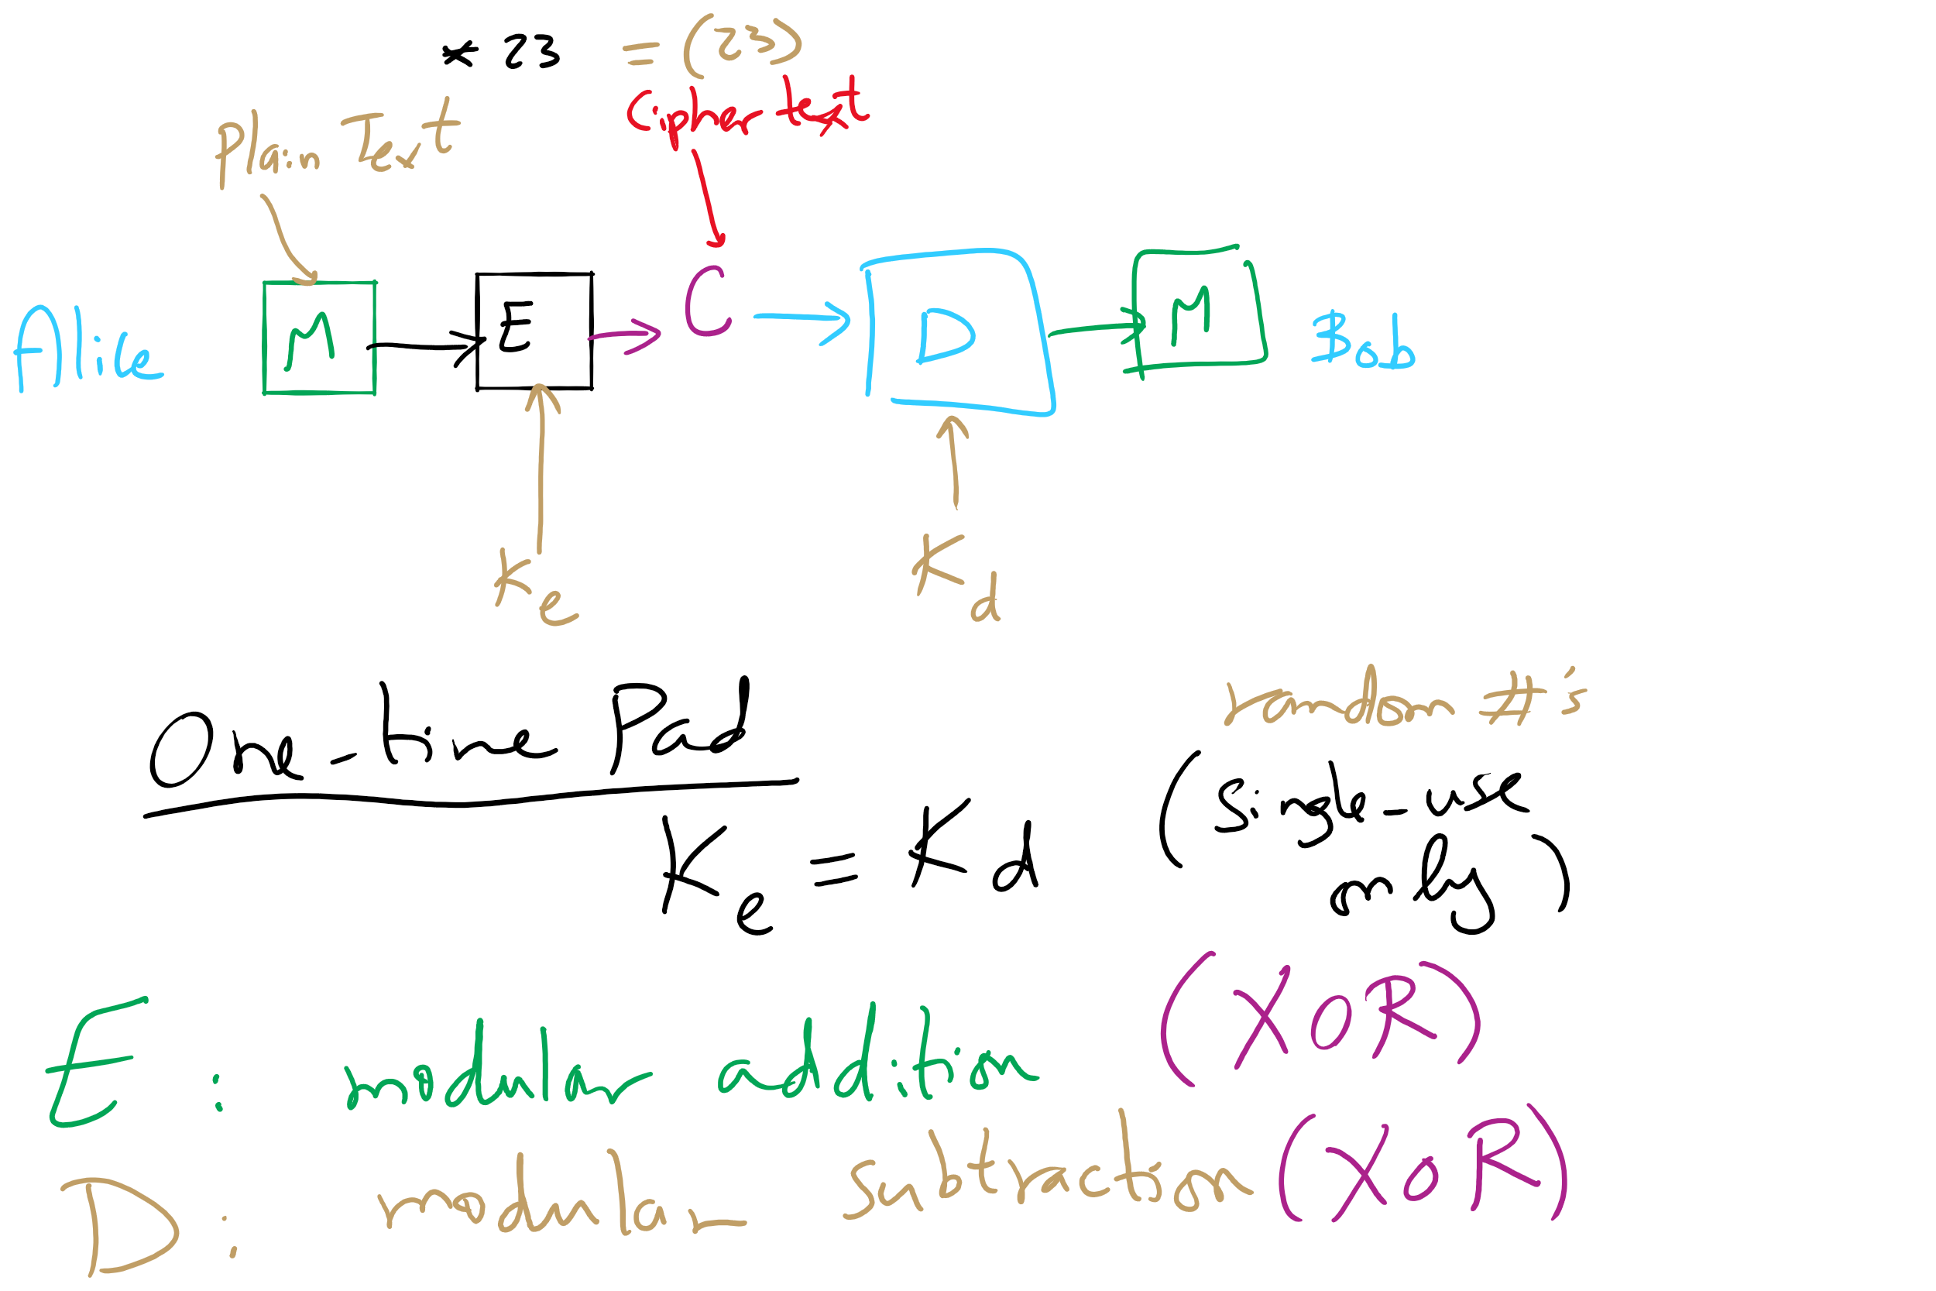
One-Time Pad

Slide 11
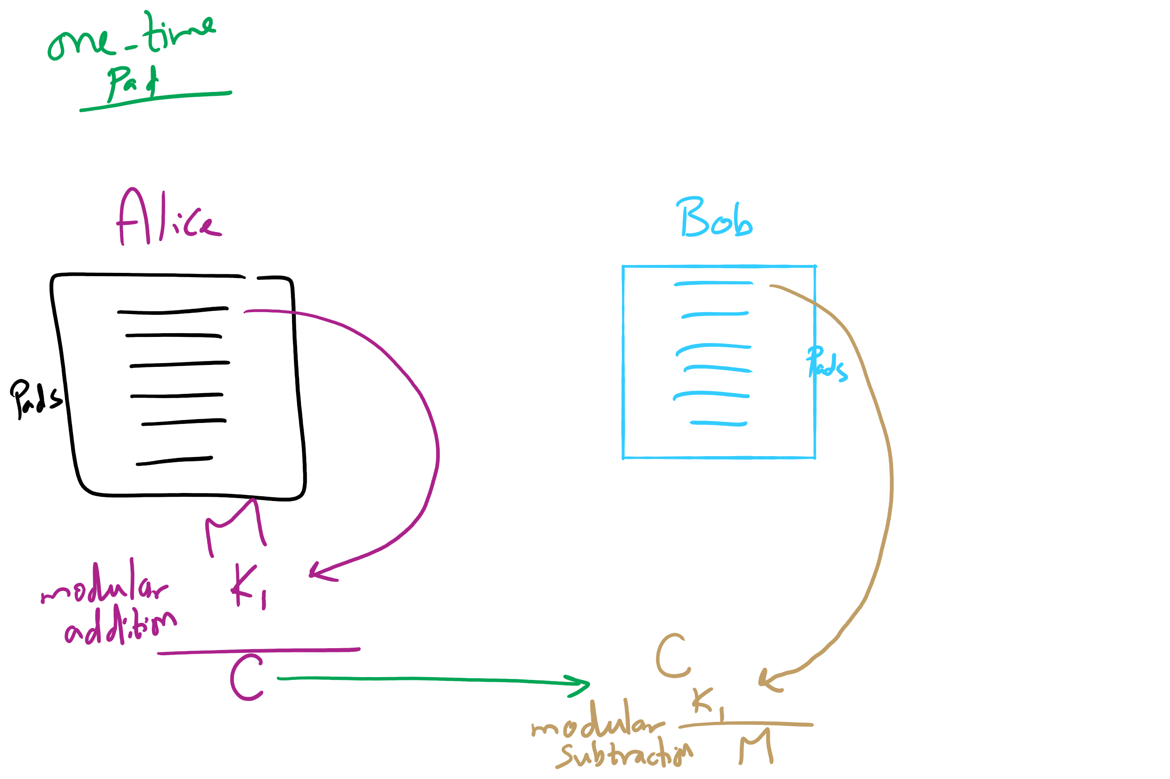
One-Time Pad

Slide 12
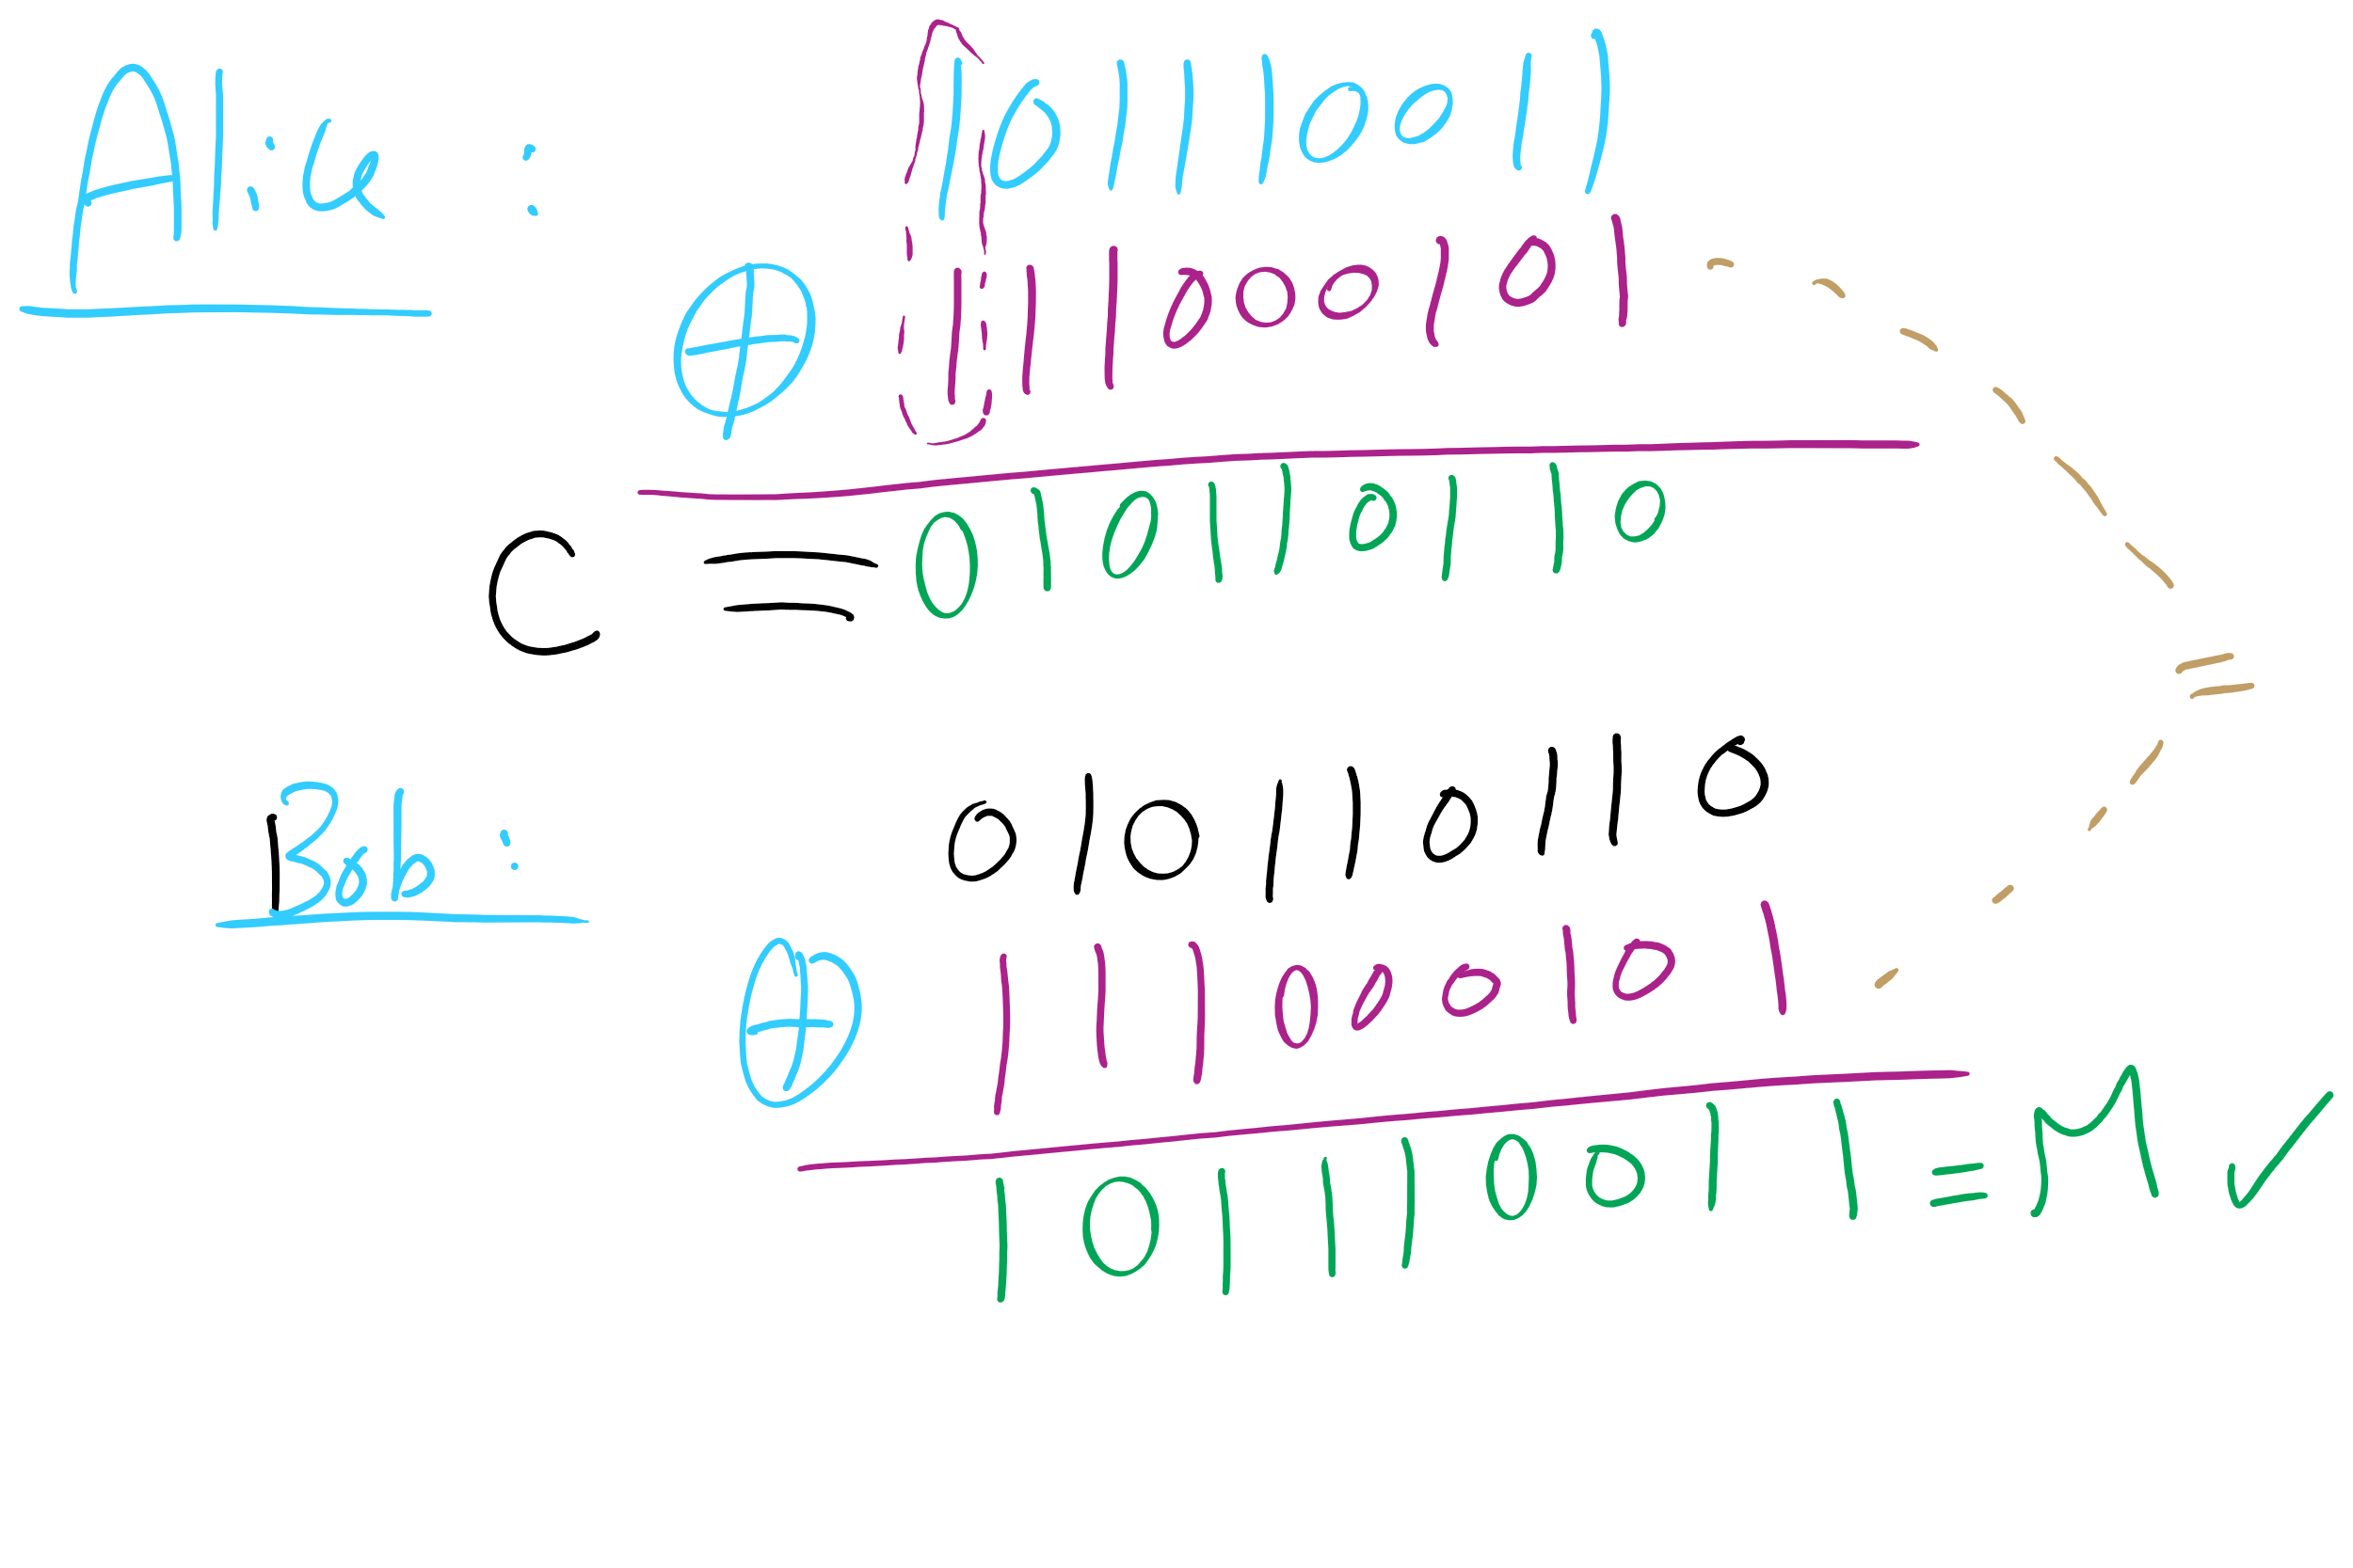
One-Time Pad Example 1

Slide 13
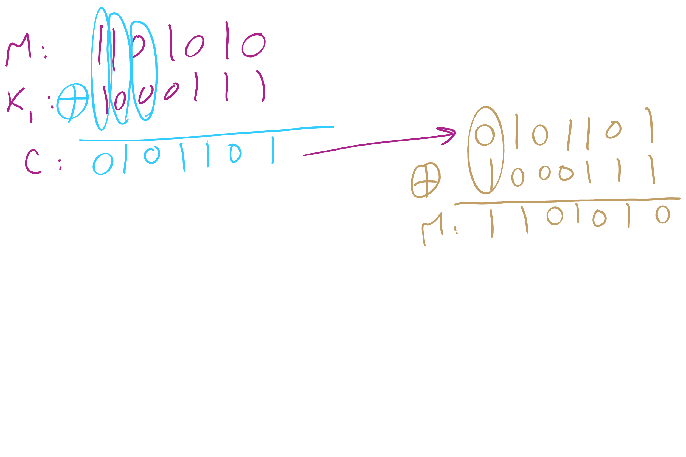
One-Time Pad Example 2

Slide 14
This Lecture
(Big)Integer Algorithms
RSA encryption
Dynamic Programming

Slide 15
Difficulties with one-time pads
Pads must be truly random
Both sender and receiver must have a matched list of pads in the appropriate order
Once you run out of pads, no more messages can be sent

Slide 16
Symmetric ciphers
Alice
M
Encrypt
C
Decrypt
M
Bob
K
K
E.g., DES, AES, Blowfish
Users share a single key
Numbers of a given bitlength (e.g., 128, 256)
Key is used to encrypt/decrypt many messages back and forth
Encryptions/decryptions will be fast
Typically linear in the size the input
Ciphertext should appear random
Best way to recover plaintext should be a brute force attack on the encryption key
Which we have shown to be infeasible for 128bit AES keys

Slide 17
Problems with symmetric ciphers
Alice and Bob have to both know the same key
How can you securely transmit the key from Alice to Bob?
Further, if Alice also wants to communicate with Charlie, her and Charlie will need to know the same key, a different key from the key Alice shares with Bob
Alice and Danielle will also have to share a different key…
etc.

Slide 18
Enter public-key encryption
Each user has their own pair of keys
A public key that can be revealed to anyone
A private key that only they should know
How does this solve our problem?
Public key can simply be published/advertised
Posted repositories of public keys
Added to an email signature
Each user is responsible only for their own keypair
Let's look at a public-key crypto scheme in detail...

Slide 19
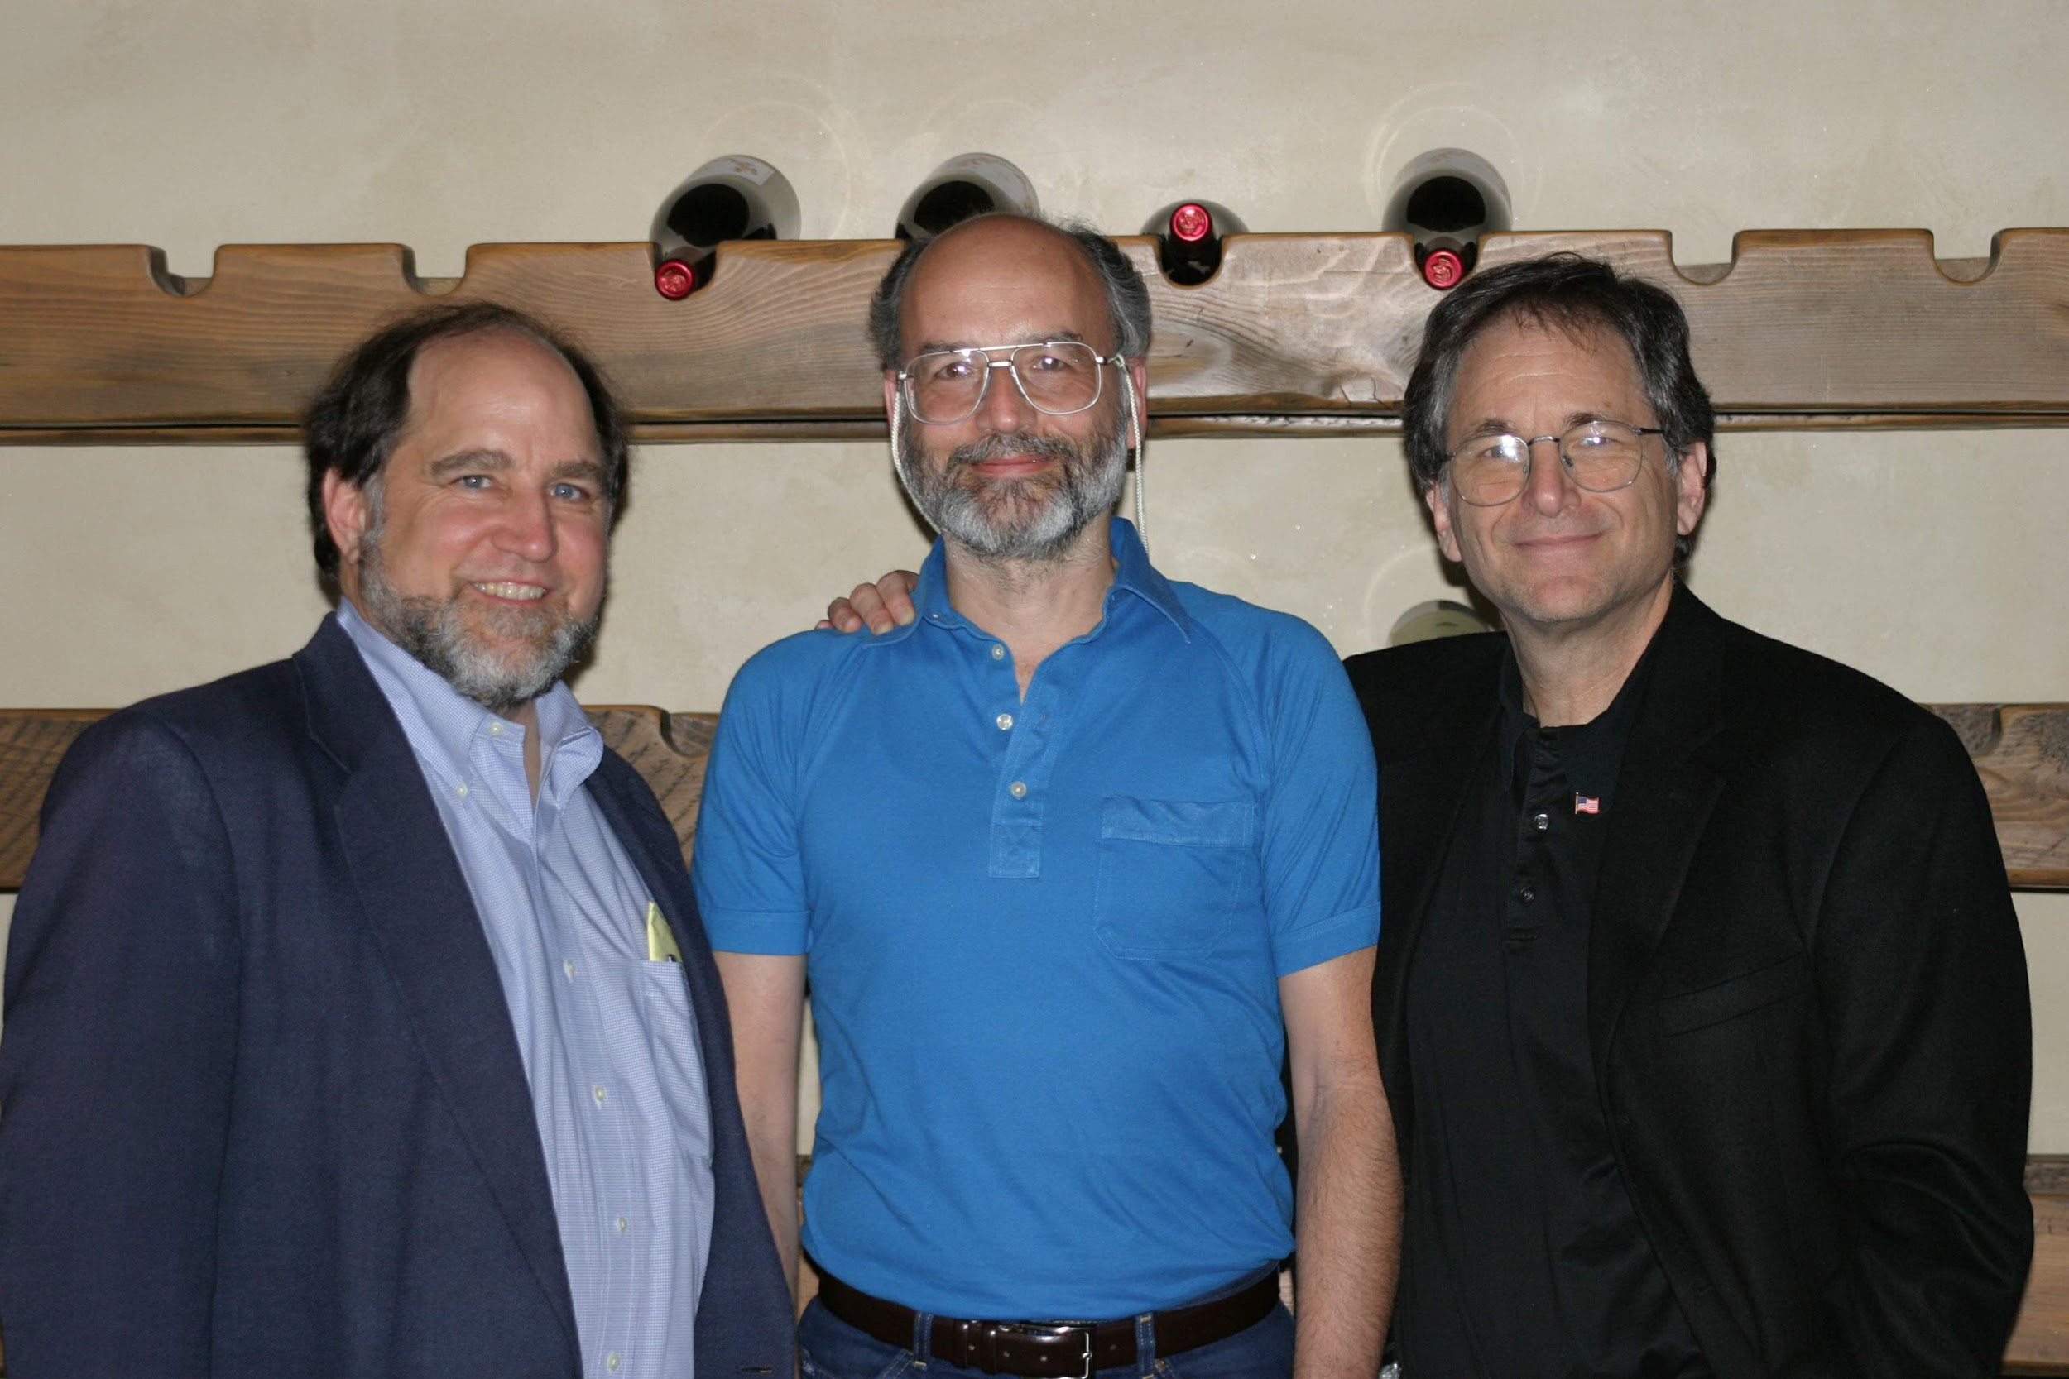
RSA
Notes:
Ronald Rivest, Adi Shamir, Leonard Adleman

Slide 20
RSA Cryptosystem in-depth
What are RSA keypairs?
How messages encrypted?
How are messages decrypted?
How are keys generated?
Why is it secure?

Slide 21
RSA keypairs
Public key is two numbers, which we will call n and e
Private key is a single number we will call d
The length of n in bits is the key length
I.e., 2048 bit RSA keys will have a 2048 bit n value
Note that "n" will be used to indicate the RSA public key component for our discussion of RSA...

Slide 22
Encryption
Say Alice wants to send a message to Bob
Looks up Bob’s public key
Convert the message into an integer: m
Compute the ciphertext c as:
c = m^{e} (mod n)
Send c to Bob

Slide 23
Decryption
Bob can simply:
Compute m as:
m = c^{d} (mod n)
Convert m into Alice’s message

Slide 24


Slide 25
n, e, and d need to be carefully generated
Choose two prime numbers p and q
Compute n = p * q
Compute φ(n)
φ(n) = φ(p) * φ(q) = (p - 1) * (q - 1)
Choose e such that
1 < e < φ(n)
GCD(e, φ(n)) = 1
I.e., e and φ(n) are co-prime
Determine d as d = e⁻¹ mod(φ(n))

Slide 26
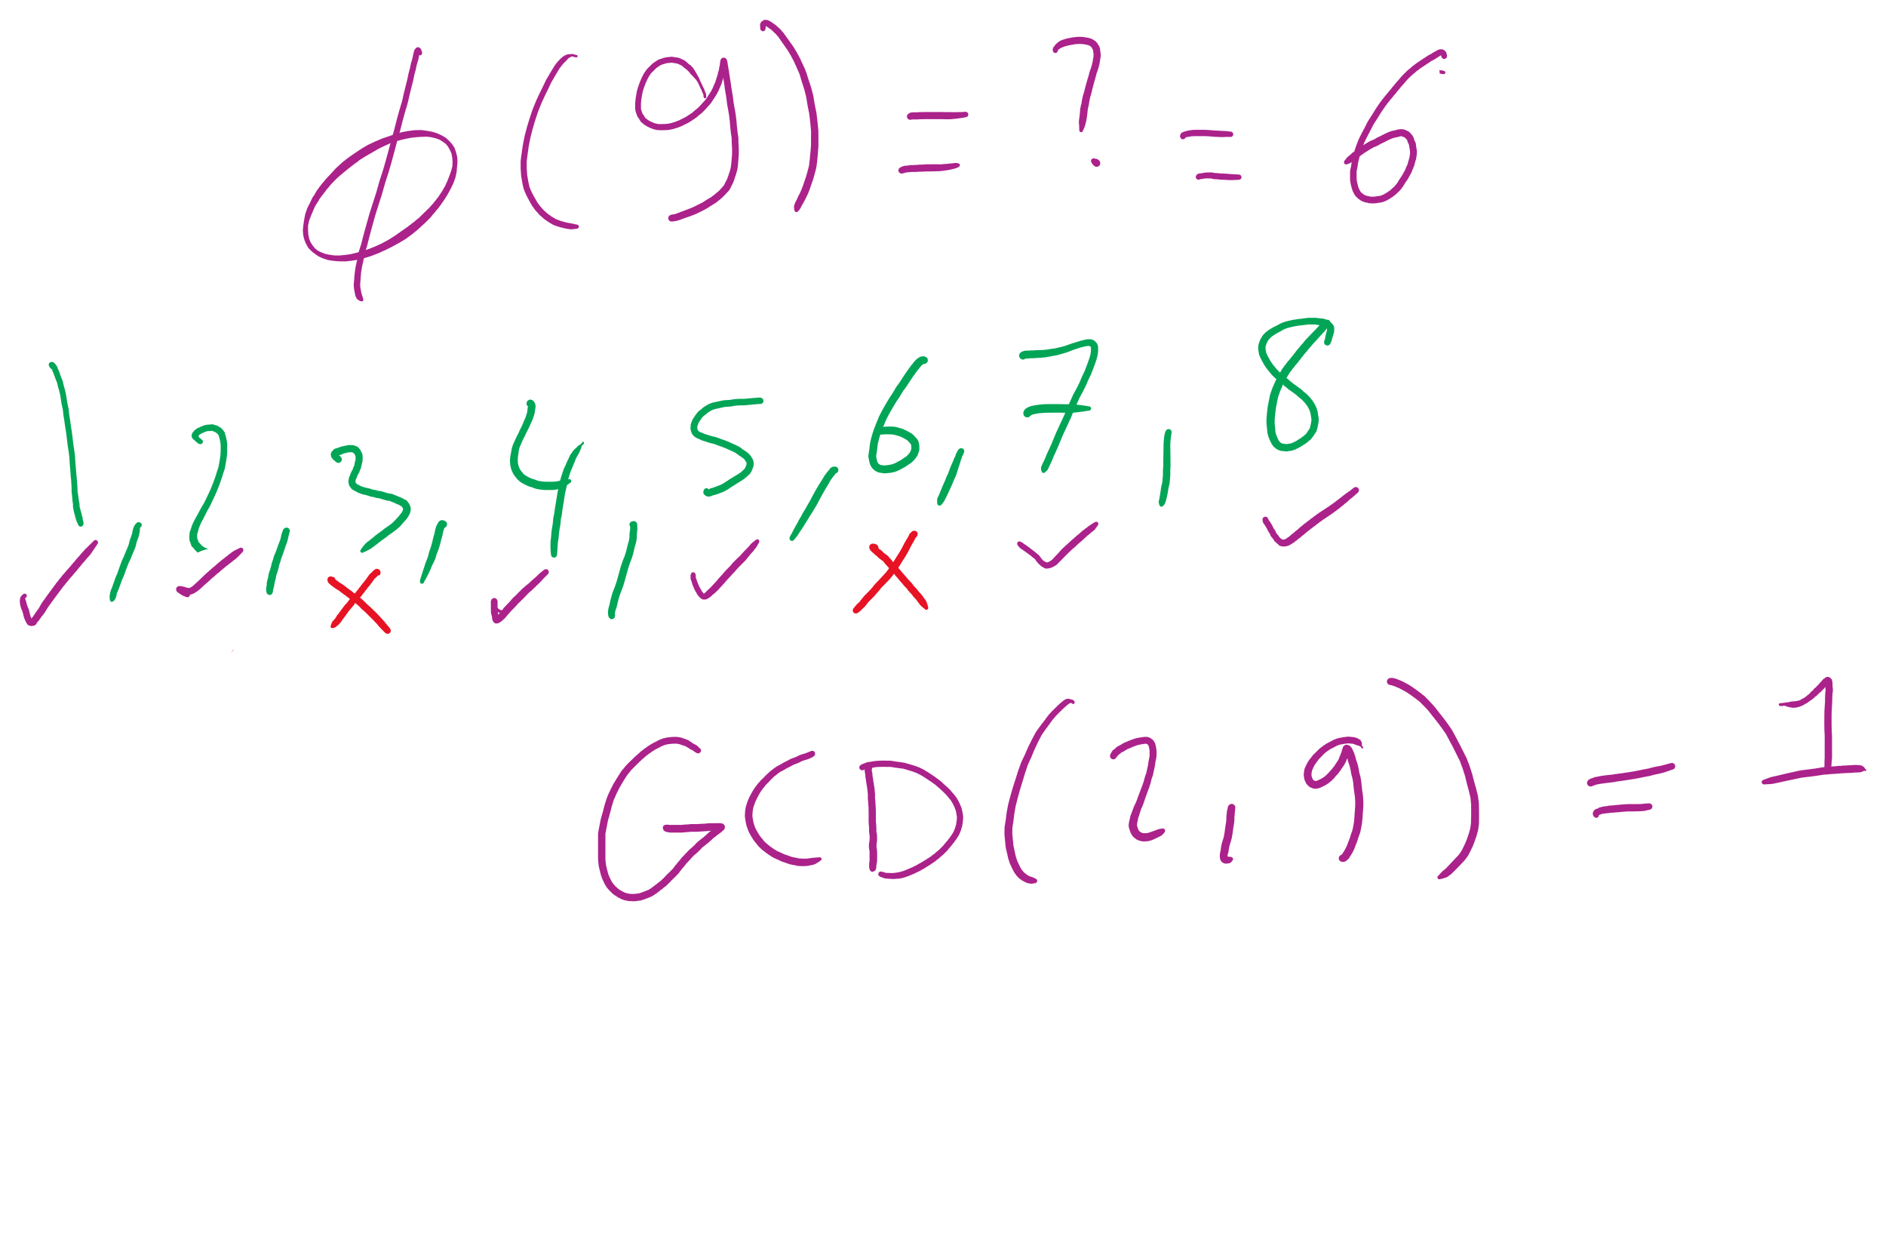
What the φ?
Here, we mean φ to be Euler’s totient
φ(n) is a count of the integers < n that are co-prime to n
I.e., how many k are there such that:
1 <= k <= n AND GCD(n, k) = 1
p and q are prime..
Hence, φ(p) = p - 1 and φ(q) = q -1
Further, φ is multiplicative
Since p and q are prime, they are co-prime, so
φ(p) * φ(q) = φ(p * q) = φ(n)
I won’t detail the proof here...

Slide 27
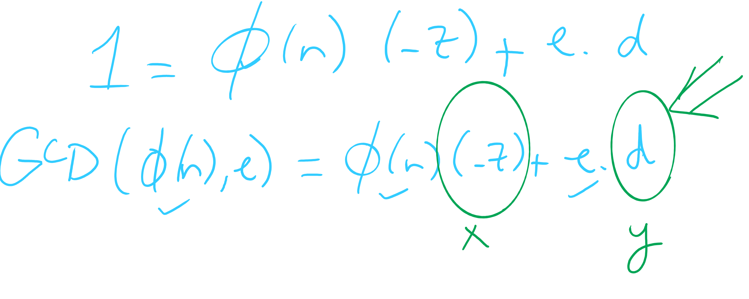
OK, now what about multiplicative inverses mod φ(n)?
d = e⁻¹ mod(φ(n))
Means that d = 1/e mod(φ(n))
Means that e * d = 1 (mod φ(n))
Now, this can be equivalently stated as e * d = z * φ(n) + 1
For some z
Can further restate this as: e * d - z * φ(n) = 1
Or similarly: 1 = φ(n) * (-z) + e * d
How can we solve this?
Hint: recall that we know GCD(φ(n), e) = 1

Slide 28
Use extended Euclidean algorithm!
GCD(a, b) = i = ax + by
Let:
a = φ(n)
b = e
x = -z
y = d
i = 1
GCD(φ(n), e) = 1 = φ(n) * (-z) + e * d
We can compute d in linear time!

Slide 29
RSA keypair example notes
p and q must be prime
n = p * q
φ(n) = (p - 1) * (q - 1)
Choose e such that
1 < e < φ(n) and GCD(e, φ(n)) = 1
Solve XGCD(φ(n), e) = 1 = φ(n) * (-z) + e * d
Compute the ciphertext c as:
c = m^{e} (mod n)
Recover m as:
m = c^{d} (mod n)
Notes:
Ready (( … )**13) % 77 in a python prompt
Advertise public key (n=77, e=37)
Request an encrypted message
What does the mod n mean for possible messages to encrypt??
Show result
Step through key gen process
p = 7, q = 11
n = 77
φ(n) = 60
select e to be 37
co-prime to 60
XGCD(60, 37) = 1 = 60 * -8 + 37 * 13
d = 13

Slide 30
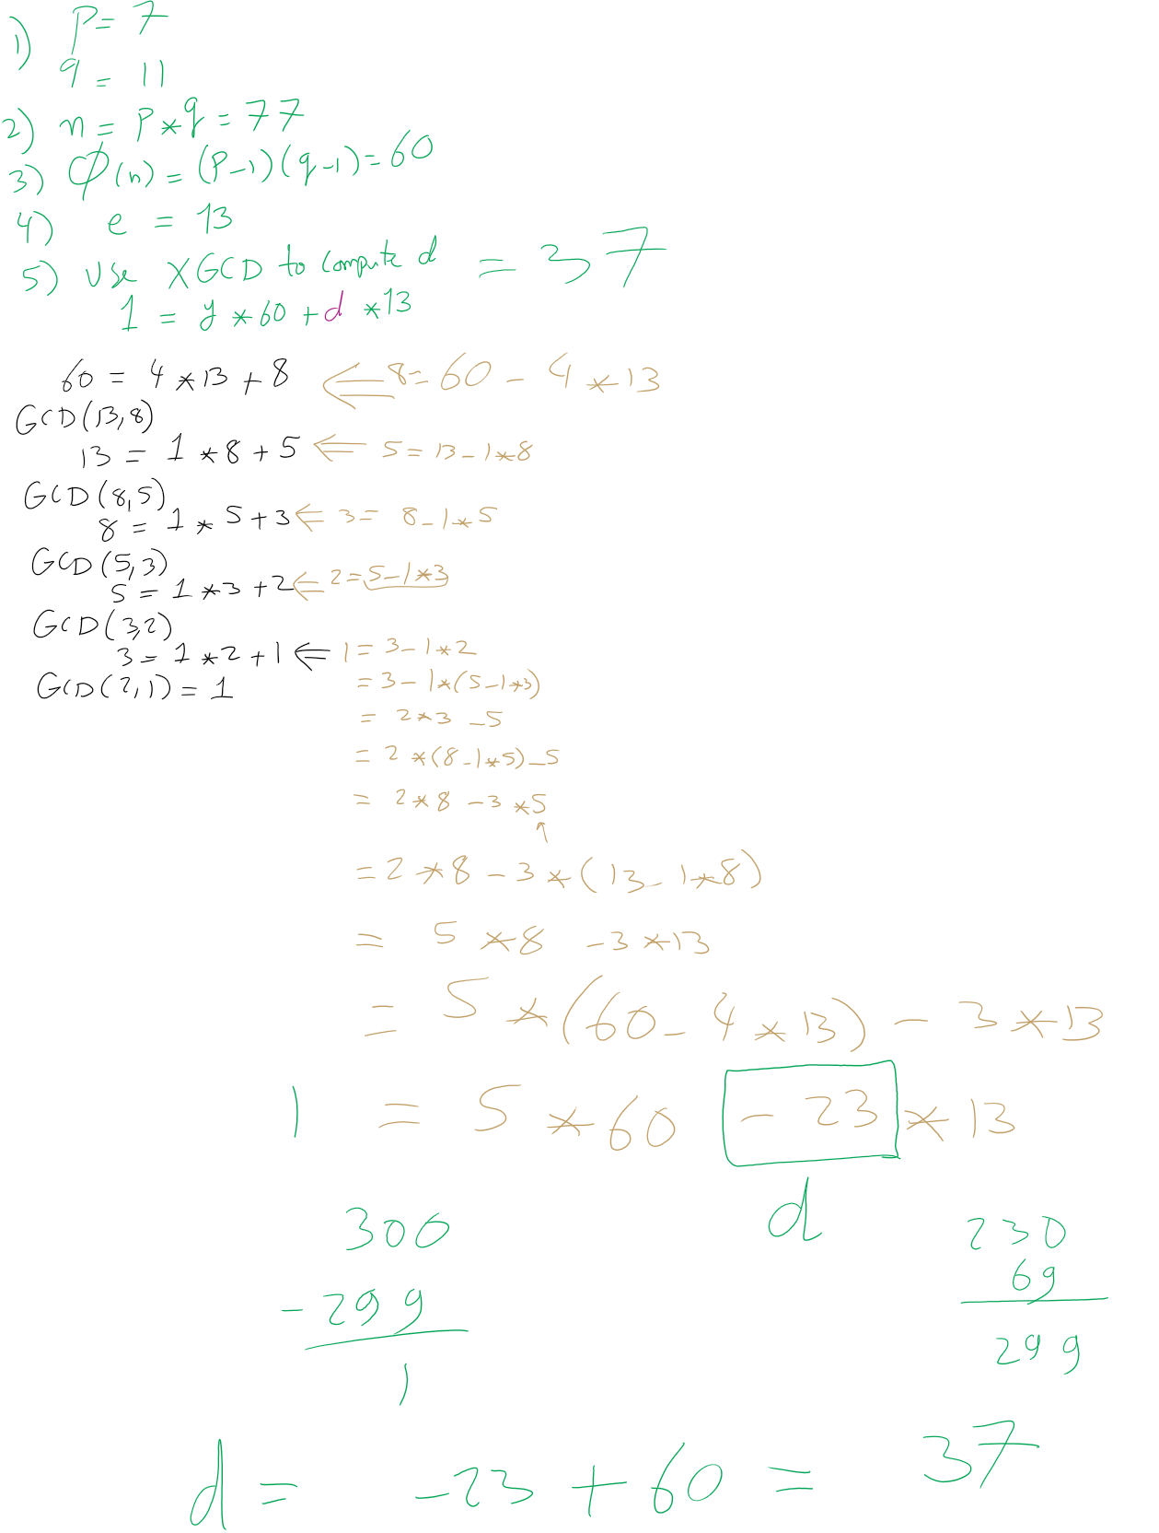
RSA Example 1

Slide 31
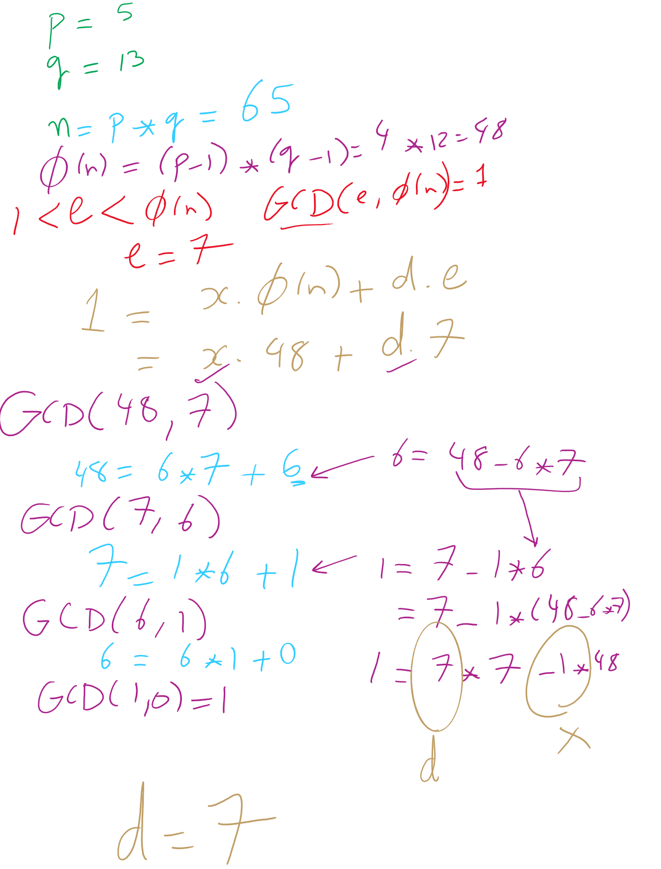
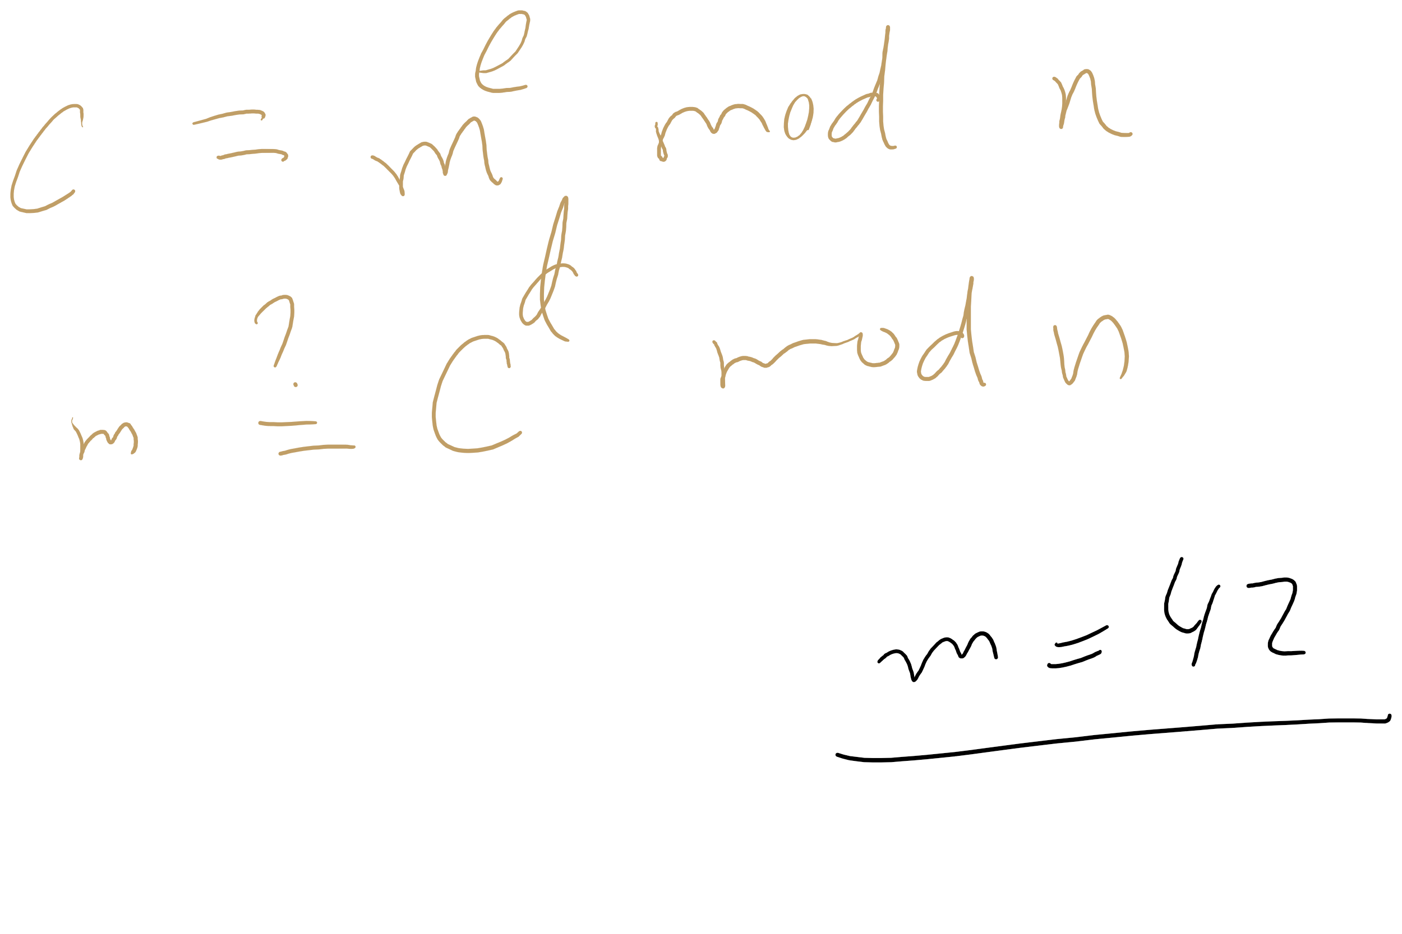
RSA Example 2

Slide 32
OK, but how does m^{ed} = m mod n?
Feel free to look up the proof using Fermat’s little theorem
Knowing this proof is NOT required for the course
Knowing how to generate RSA keys and encrypt/decrypt IS
For this course, we’ll settle with our example showing that it does work

Slide 33
Why is RSA secure?
4 avenues of attack on the math of RSA were identified in the original paper:
Factoring n to find p and q
Determining φ(n) without factoring n
Determining d without factoring n or learning φ(n)
Learning to take e^{th} roots modulo n

Slide 34
Factoring n
To the best of our knowledge, this is hard
A 768 bit RSA key was factored one time using the best currently known algorithm
Took 1500 CPU years
2 years of real time on hundreds of computers
Hence, large keys are pretty safe
2048 bit keys are a pretty good bet for now

Slide 35
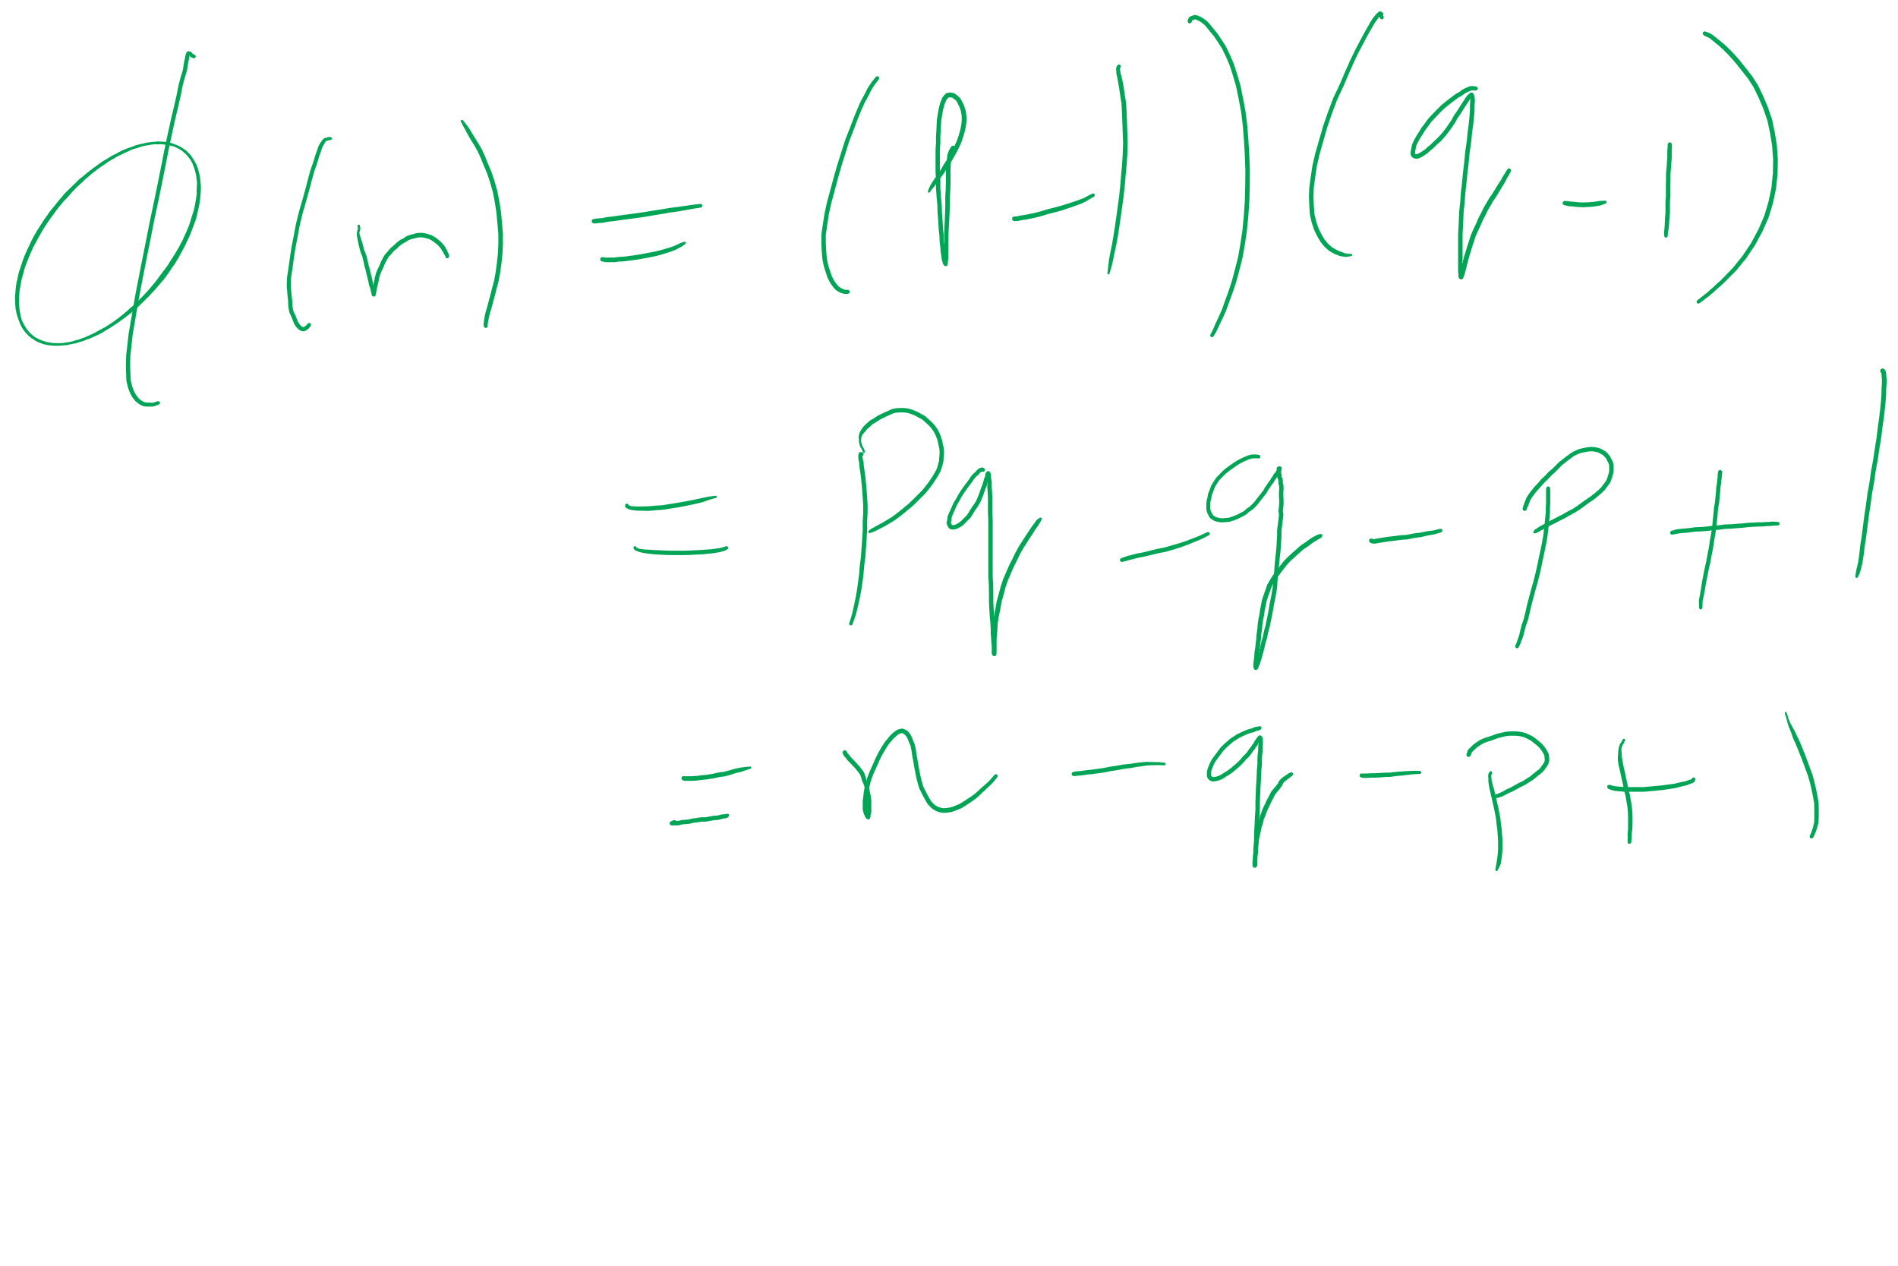
What about determining φ(n) without factoring n?
Would allow us to easily compute d because ed = 1 mod φ(n)
Note:
φ(n) = n - p - q + 1
φ(n) = n - (p + q) + 1
(p + q) = n + 1- φ(n)
(p + q) - (p - q) = 2q
Now we just need (p - q)...
(p - q)² = p² - 2pq + q²
(p - q)² = p² + 2pq + q² - 4pq
(p - q)² = (p + q)² - 4pq
(p - q)² = (p + q)² - 4n
(p - q) = √((p + q)² - 4n)
If we can figure out φ(n) efficiently, we could factor n efficiently!

Slide 36
Determining d without factoring n or learning φ(n)?
If we know, d, we can get a multiple of φ(n)
ed = 1 mod φ(n)
ed = kφ(n) + 1
For some k
ed - 1 = kφ(n)
It has been shown that n can be efficiently factored using any multiple of φ(n)
Hence, this would provide another efficient solution to factoring!

Slide 37
Learning to take e^{th} roots modulo n
Conjecture was made in 1978 that breaking RSA would yield an efficient factoring algorithm
To date, it has been not been proven or disproven

Slide 38
This all leads to the following conclusion
Odds are that breaking RSA efficiently implies that factoring can be done efficiently.
Since factoring is probably hard, RSA is probably safe to use.

Slide 39
Implementation concerns
Encryption/decryption:
How can we perform efficient exponentiations?
Key generation:
We can do multiplication, XGCD for large integers
What about finding large prime numbers?

Slide 40
Efficient exponentiation for RSA
Does this solve our problems?
ans = 1
foreach bit in y:
ans = (ans² mod n)
if bit == 1:
ans = (ans * x mod n)
ans = 1
foreach bit in y:
ans = ans²
if bit == 1:
ans = ans * x
How can we improve runtime for RSA exponentiations?
Don’t actually need x^{y}
Just need (x^{y} mod n)

